Slide 1
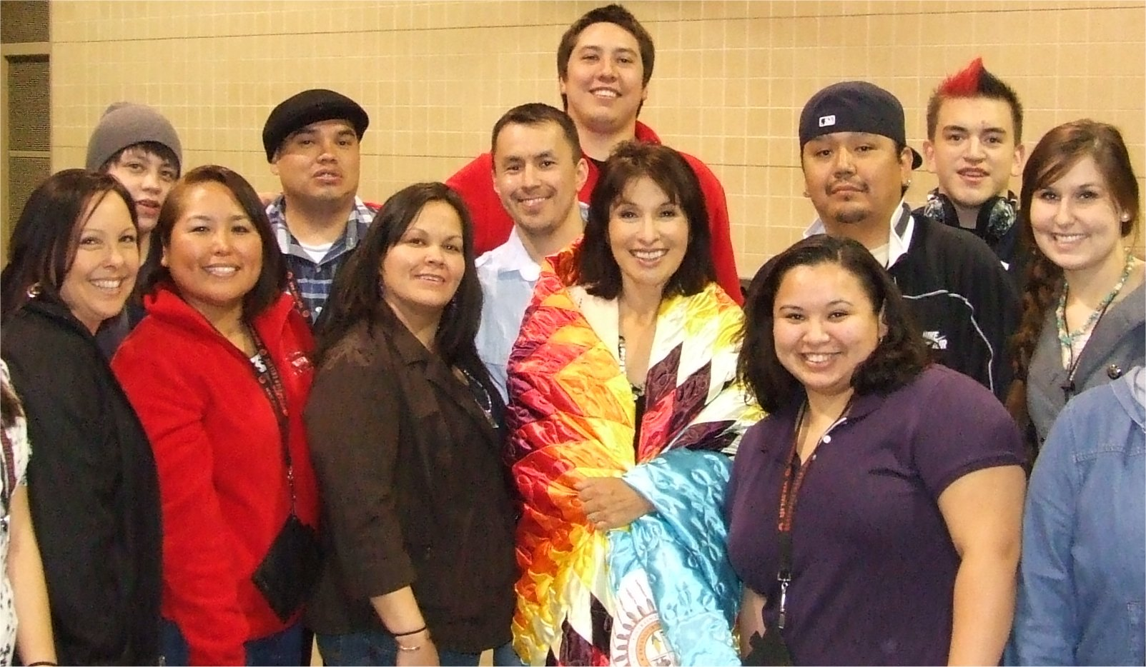
Northwest Indian College’s Landscape of Teaching and Learning

Slide 2
“You can teach them to pull canoe or you can teach them to want to pull canoe.” Willie Jones, Sr., Native Studies faculty and one of the founders of Northwest Indian College. A long-time canoe skipper, Willie often shares how he learned leadership and teaching through canoe pulling.

Slide 3
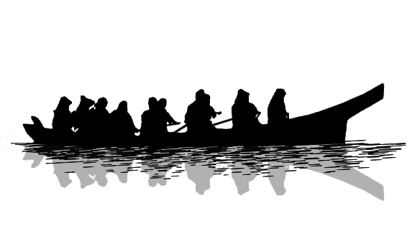
Intellectual Capacity Building
What is it for students to want to pull canoe?
Educational aspirations
Dreams of the ancestors
For future generations
Results in:
Restorative experience
Personal sovereignty
Student motivation
Student engagement
We build this capacity through a focus on faculty development and support for Native voices and leadership
Notes:
What has it meant for us to help our students want to pull the canoe? It is a cultural metaphor for their educational aspirations which fulfills the dreams of their ancestors and is the vision for future generations:
Strengthen the restorative experience of cultural and personal sovereignty through our cultural outcomes – what is it to be a people and building a sense of place.
Emerge motivation of student to be an educated person
Increase the ways that students engage personally and with others in their own education

Slide 4
Strategies for Building Intellectual Capacity Faculty Development and Native Leadership
Historic and modern Native experience
Development of resources and skills
Leadership development
Notes:
We deliberately focused on strengthening faculty knowledge of the historic and modern Native experience. We developed comprehensive teaching and learning resources, online handbook, teaching toolkit, and promoted scholarship in teaching and learning through faculty action research projects. We supported Native leadership development and training.

Slide 5
Achievements of the Project
Improved knowledge, skills and abilities of faculty leading to improved student success
Complemented institutional initiatives focused on student success measures
Faculty are able to improve their teaching practices
Notes:
NWIC improved the knowledge, skills and abilities of its faculty, particularly emerging Native faculty, to engage the teaching and learning process toward improved student success. Our Woksape Oyate project complemented institutional program development, assessment, and our increased focus on student completion of courses, educational goals and degree programs. We learned that with persistent and deliberate support, tribal college faculty, whether new or experienced, are able to improve their teaching practices.

Slide 6
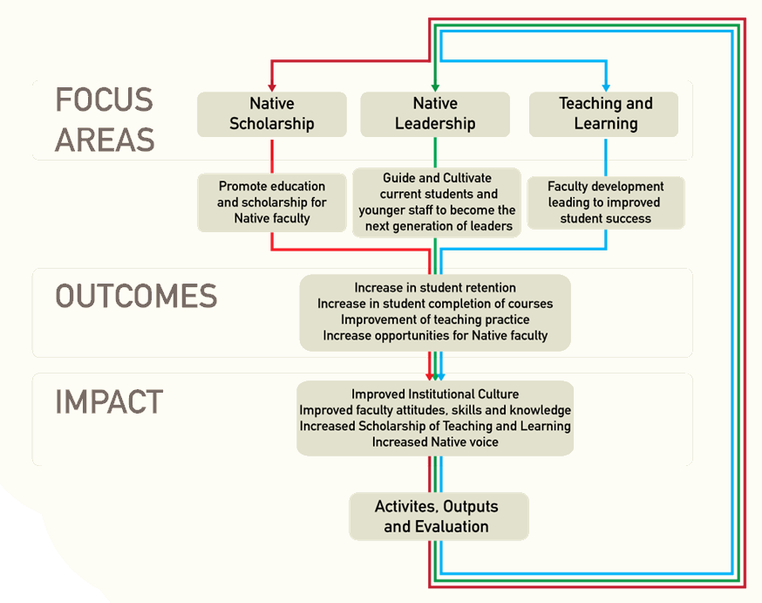
Notes:
This diagram describes three focus areas of our Woksape Oyate project: promoting Native scholarship, cultivating Native leadership, and fostering faculty development. The outcomes of our activities and outputs result in measures of improved student success, improved teaching practices and greater opportunities for Native faculty growth and scholarship. This builds the institutional capacity to address the College mission, improve faculty skills and knowledge necessary to address student needs, and to increase the Native voice in all aspects of the teaching and learning process.

Slide 7
Measures and Evaluative Tools
Survey of Teaching and Learning Environment at NWIC (2009 and 2011)
Course Evaluations (quarterly)
Community College Survey of Student Engagement (2005 and 2011)
Faculty Classroom Evaluations (annually)
Evaluations/comments from the Teaching and Learning Institutes
Institutional Data (course completion, retention and graduation rates)
Anecdotal evidence from observations, debriefings and discussions
Student and faculty focus groups
Notes:
We are using a variety of tools to grasp the impact of our Teaching and Learning Initiative on intellectual capacity building at NWIC. These are examples of some of the tools. We also have additional surveys and questionnaires and evaluations of presentations and workshops.

Slide 8
NATIVE SCHOLARSHIP
Notes:
This photo shows our first graduate of the Bachelor of Science in Native Environmental Science, Jessica Urbanec, who is now a teaching assistant, working with a 2011 graduate of the program, Lora Boome.

Slide 9
Native Scholarship Institutional Impact
NWIC mission: Through education, NWIC promotes indigenous self-determination and knowledge – increased clarity – focus on sovereignty and indigenousness
Teaching and Learning Environment - surveys - institutional practices
NWIC Philosophy of Teaching and Learning
Creating a Landscape for Teaching and Learning article
Notes:
Through this process we increased the clarity of the NWIC mission as it relates to teaching and learning, which focuses on indigenousness and sovereignty. We studied the Teaching and Learning Environment at NWIC using surveys, discussed perceptions with faculty and administration, and used the results to influence institutional practices. We developed an NWIC Philosophy of Teaching and Learning. We produced a paper that tells the story of the NWIC Teaching and Learning Initiative titled Creating a Landscape for Teaching and Learning. It is planned for eventual publication.

Slide 10
Native Scholarship in Action
Strengthen pedagogy of teaching and learning from a tribal college perspective
Native faculty - presentations - course development - academic decision making
Action research projects
Advanced degrees
Case study development
Native studies 4-year degree - Traditional tribal leadership - Indigenousness - Sovereignty - Program & Course Outcomes
Lummi Language courses and curriculum
Annotated bibliography
Professional conferences
Notes:
Increased participation of Native faculty as presenters and resources for pre-service and in-service, increased involvement in course development and in academic decision making. Examples include: pursuing action research projects, enrolling in advanced degree coursework and degree completion. case study development in partnership with The Evergreen State College Enduring Legacies Project, development of the vision, outcomes, course design of a 4-year Native Studies program of study, Lummi Language curriculum development and teaching, development of an annotated bibliography of Coast Salish resources, and attendance at professional conferences.

Slide 11
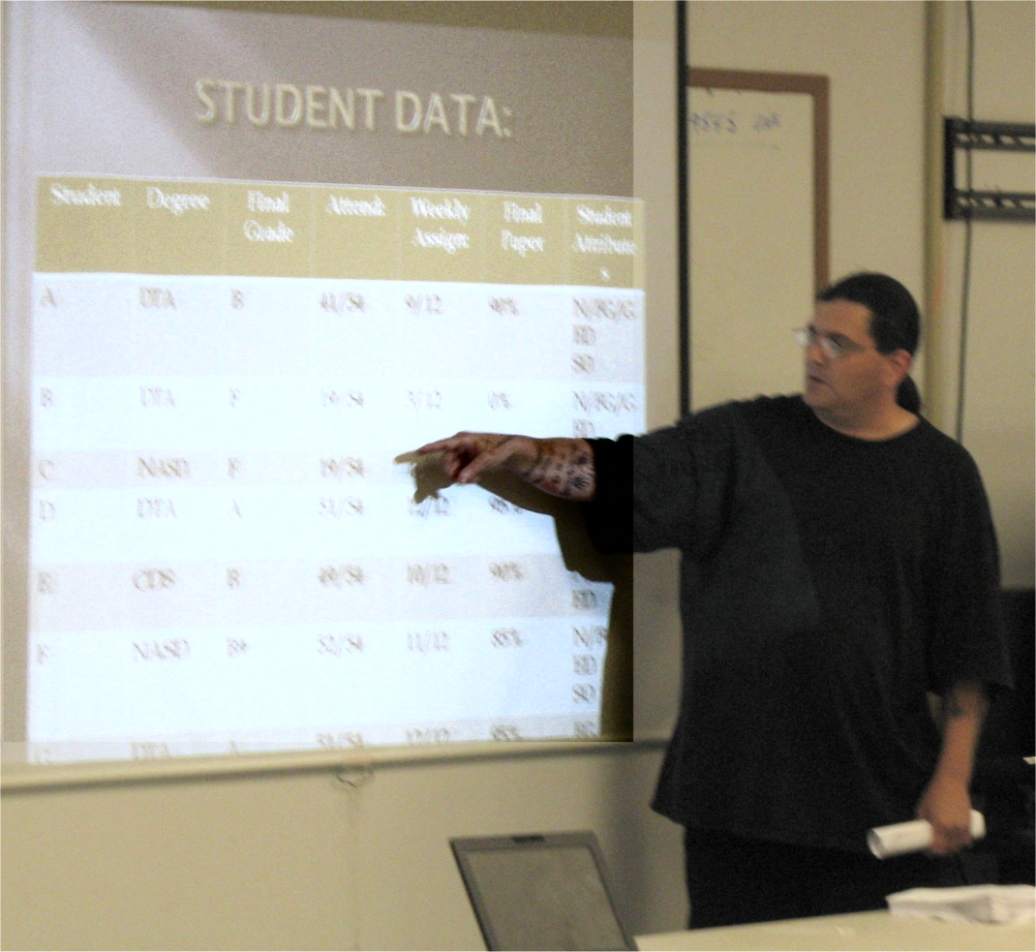
Native Scholarship
Don McCluskey, Lummi faculty member, action research in teaching and learning presentation at the 2011 Teaching and Learning Institute (click to view video)

Slide 12
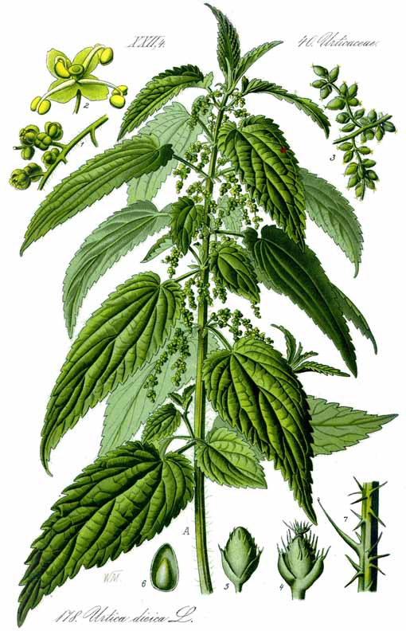
Action Research Project Dispelling the Myth Of Indian Time
Instructor: Don McCluskey
Project intervention: connect punctuality and successful completion of assignments to traditional fishing practices
Assessment: - Improved student experience - Culturally relevant experience
Notes:
Instructional intervention: Reward students for punctual regular behavior and successful completion of assignments with a non-monetary paper (index cards), metaphorically representing a historical natural resources (nettles) which were used to fashion traditional fishing nets.
Assessment: Improved experience of already committed students, created a culturally relevant experience for both committed students and those who were struggling to meet course expectations

Slide 13
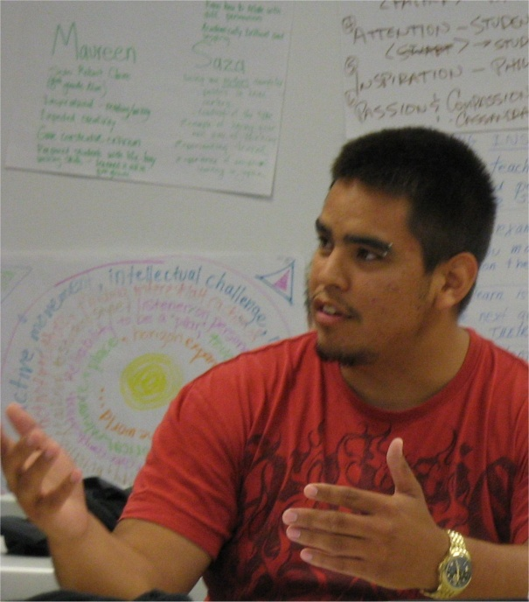
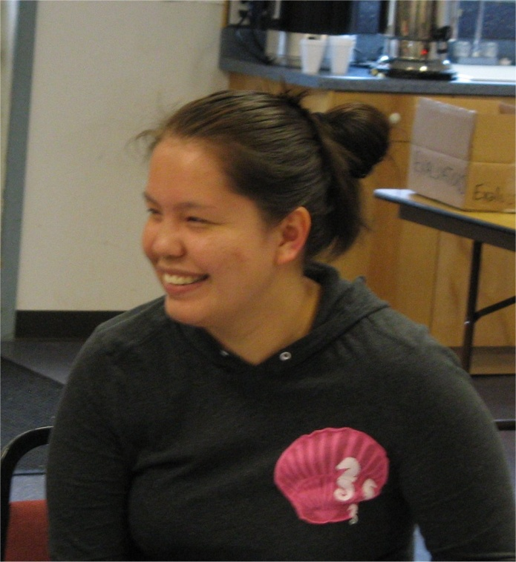
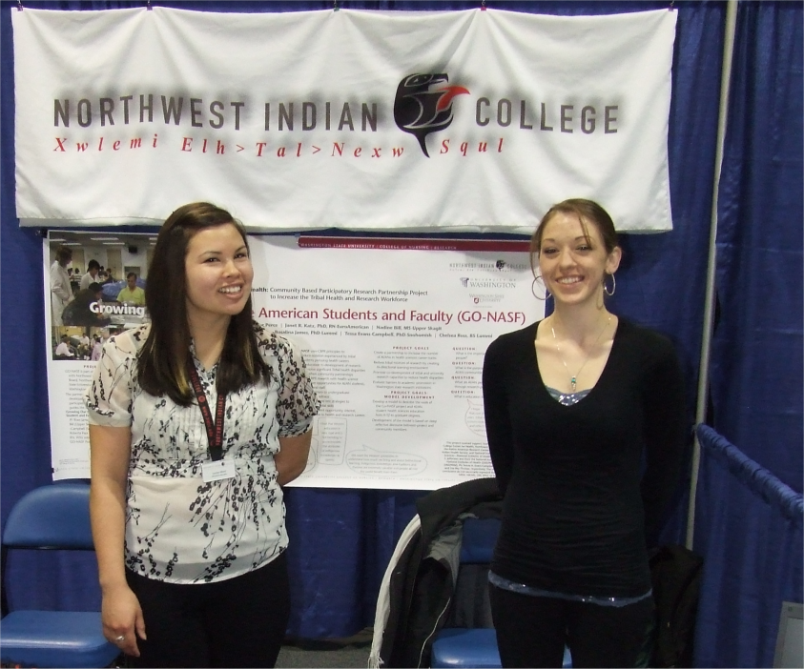
Native Leadership
Notes:
From left to right: Carmen Bland and Chelsea Ross representing NWIC at an AIHEC conference, Coast Salish Institute faculty, Lucas Washington and Lexie Tom, at the 2011 Teaching and Learning Institute.

Slide 14
Cultivating our Next Generation of Tribal and College Leaders
Emerging leaders cohort
Conferences participation
Emerging Native scholars and faculty
Develop resident expertise
Native Studies 4-year program of study development
Institutional teams and committees
Represent College to communities
Accreditation participation
Notes:
Examples: participation in the Emerging Leaders Cohort uses the NWIC Traditional Tribal Leadership Curriculum and other resources for leadership development, recruitment of emerging scholars and faculty into NWIC faculty positions, development of resident expertise shared throughout the institution and with tribal communities, serving as the primary group to learn about, design and propose the new 4-year Native Studies program of study, serve on institutional teams and committees, present to constituents on behalf of the President, and offer reflections on institutional experiences such as accreditation site reviews.

Slide 15
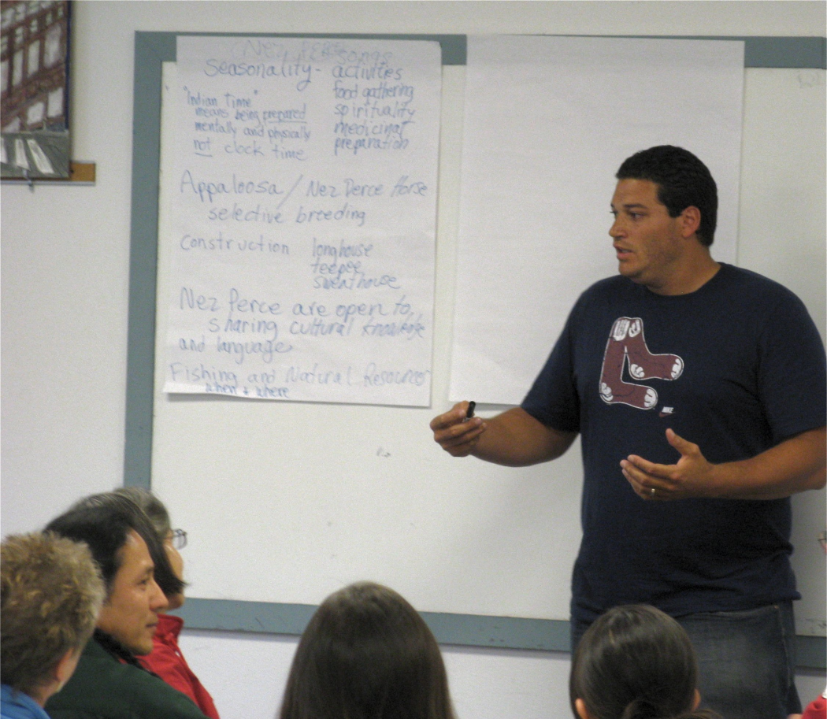
Emerging Native Leadership
Click to view video of Greg Mahle discussing the qualities of Native leadership
at the 2010 Teaching and Learning Institute

Slide 16
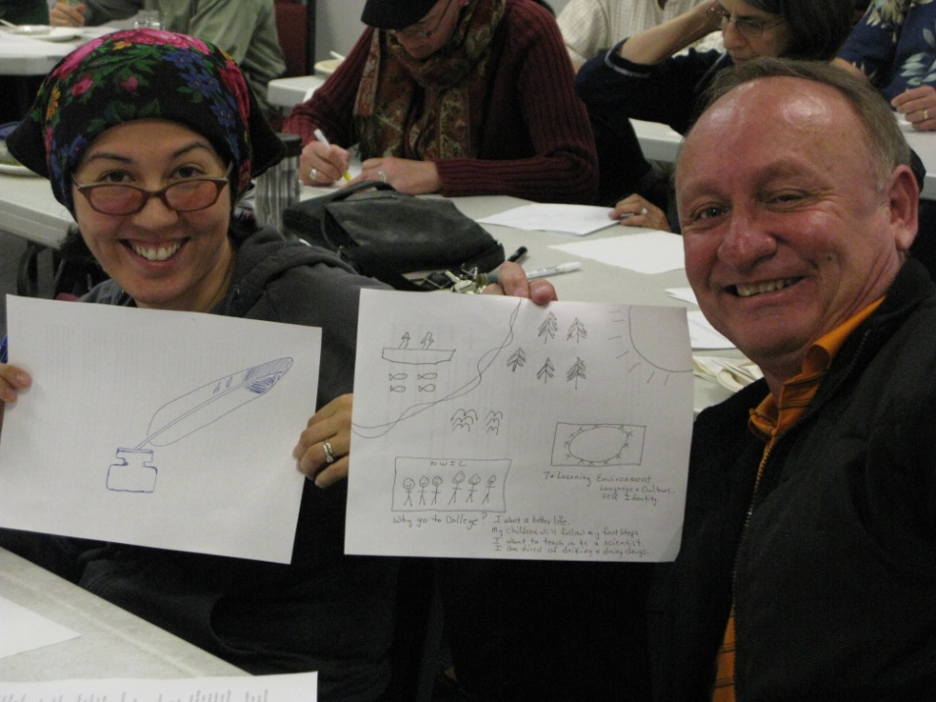
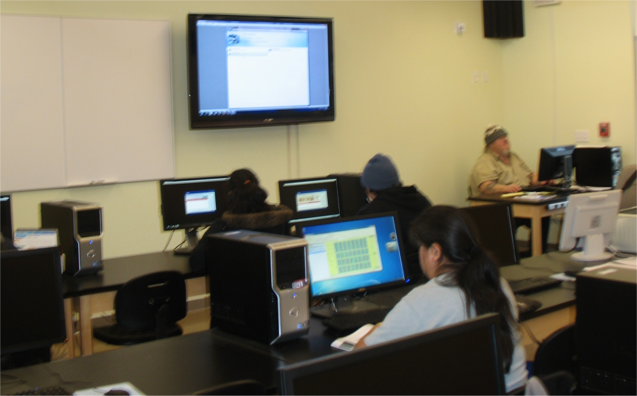
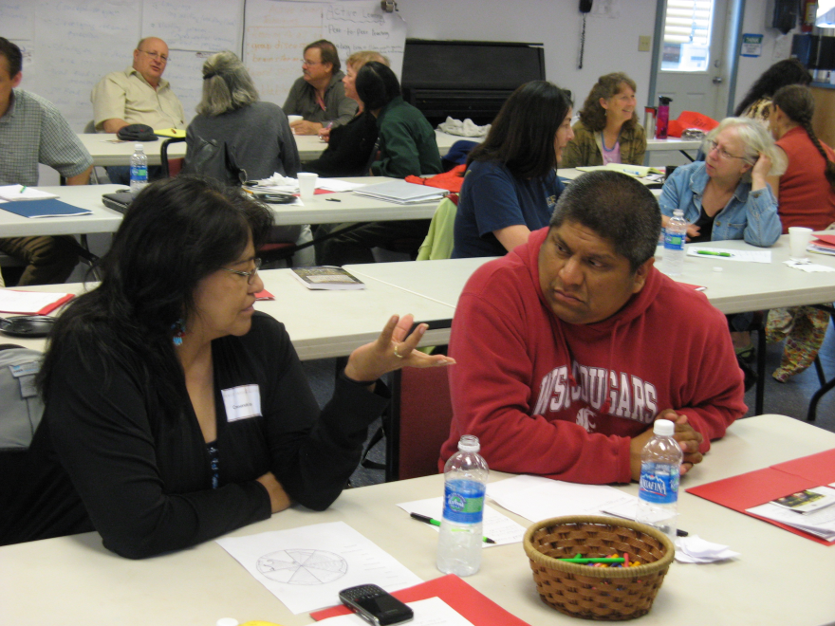
Teaching and Learning
Notes:
Top photo: NWIC faculty Rena Priest and Alex Prue showing off their quilt square designs that express their view of teaching and learning at NWIC. Bottom left photo: Nez Perce faculty Cassandra Kipp and Phill Allen at the 2011 Teaching and Learning Institute. Bottom right: Mark Moss teaches computers in the new Native Environmental Science building.

Slide 17
Teaching and Learning Initiative
Woksape Oyate goals:
Increase student course completion
Increase student Fall-to-Fall retention
Improve teaching practices
Improve opportunity for Native scholarship and leadership
Purpose of Teaching and Learning Initiative:
Institutionalize strategies
Faculty self-knowledge
Impact faculty skills :
Teaching
Cultural integration
Content
Notes:
The purpose of the Teaching and Learning Initiative is to institutionalize and integrate Woksape Oyate strategies with all NWIC student learning and cultural development initiatives, support faculty with self-knowledge so they are healthy, skilled, and focused on student learning, improve faculty skills in teaching, cultural integration and content areas.

Slide 18
Strategies and Outputs
Teaching Toolkit - Pre/in-service training - Faculty designed
Action Research Projects - Training - Link with Assessment
Website and print resources
Teaching and Learning Committee
Philosophy of Teaching and Learning
Teaching and Learning Institutes (2010 and 2011)
Program outcomes
Assessment strategies
Program, course and faculty evaluations
Curriculum development

Slide 19
Evaluation Questions
How do we know and in what ways have faculty improved their teaching and learning skills, content knowledge, cultural integration and methodologies?
In the three areas of impact – faculty, students and institution-wide - what are we learning and how will we know?

Slide 20
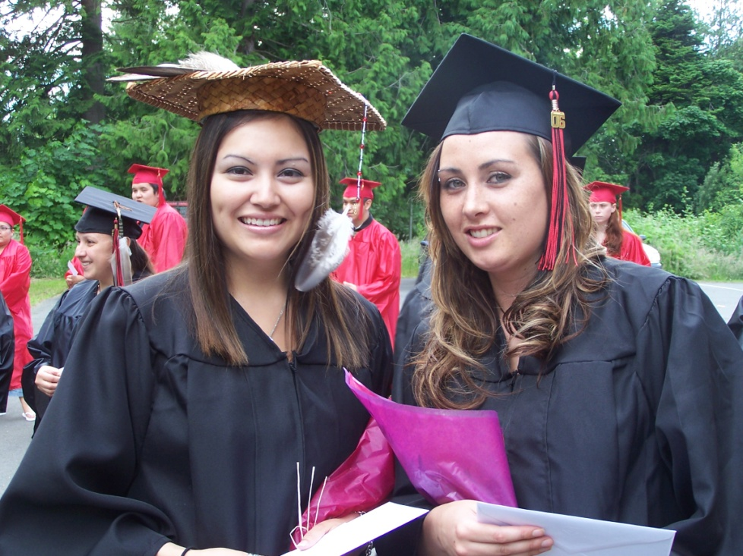
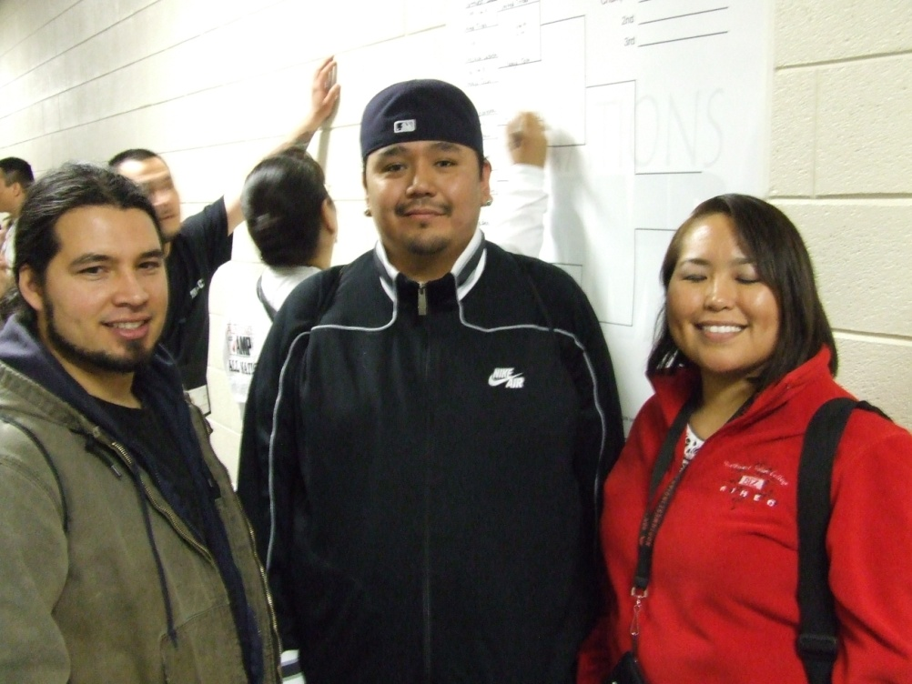
Impact on Students

Slide 21
Course Evaluations
Revised – from 22 to 6 questions - more focused approach
- teaching and cultural knowledge
Questions about the course, the instructor and comments.
Question - instructor created a learning environment that supported optimal learning
Question – course made connections to tribal and Native American topics
Analyze course evaluation results
Notes:
Course Evaluations were revised in 2009 to focus solely on teaching and learning. The six questions represent a more focused approach to specifically ask students about the quality of teaching and the inclusion of cultural knowledge. The six questions where divided into parts: questions about the course and questions about the instructor, plus comments, strengths and recommendations. Results for the course evaluations are analyzed to look for trends over time and used to make individual and institution-level changes.

Slide 22
Student Comments
I enjoyed myself a lot in this class. I learned so much and it helped to decide to go after my BS degree in ethno botany.
The instructor was supportive of every element of my class. He also built on previous experience and the most important thing was how he had access on information that was relevant to my region.
The instructor in this class made a real turn around in his teaching methods and made math something I wanted to learn not something I had to take. Good job.

Slide 23
Student Comments
I loved the off campus experiences and the learning we did through observation and self examination. The students in this class were very supportive and sincere making a great environment for discussion. The case studies and presentations were a highlight and a great `out of the box` way to understand sociology.
The course was fantastic. It was culturally relevant and provoked much thought from me.
The Native American content is Awesome!

Slide 24
Student Perspectives
Community College Survey of Student Engagement (CCSSE)
Benchmarks for Effective Educational Practice - 2011 Comparative Data
Notes:
The 2011 CCSSE cohort comparison represents the average values for all participating colleges. Note that while the NWIC value for academic challenge is less than the cohort average it is an increase of 2.1% over the 2005 results, as shown on the next slide.

Slide 25
Student Perspectives Comparison of 2005 and 2011 CCSSE Responses
CCSSE Benchmark | 2005 Report 124 participants | 2011 Report 233 participants | % change
Active & Collaborative Learning | 52.8% | 54.8% reported active engagement | +2%
Student Effort | 51%% | 51.5% reported their perceptions of how their own behavior influenced learning | +0.5%
Academic Challenge | 45.9% | 48.0% reported intellectually challenging experiences | +2.1%
Student-Faculty Interaction | 66% | 57.4% reported high levels of contact | -8.6%
Support for Learners | 59.4% | 55.9% reported high non-academic and academic supports | -3.5%
Notes:
Note that the 2011 CCSSE survey had a higher representation from students from the NWIC educational sites. Because of staffing and location, it is reasonable to assume that students at sites would have less access to instructors since most site faculty are part-time.

Slide 26
Impact on Students Annual Course Completion Rate (college level courses)
Academic Year | Projected rate | Actual rate | % change from prior year
06-07 | 68% (actual) | 68%
07-08 | 72% | 76% | +8%
08-09 | 76% | 79.6% | +3.6%
09-10 | 80% | 78% | -1.6%
10-11 | 84%
From 06-07 to 09-10 |  |  | +10% from beginning of project
* source: NWIC Registrar
Notes:
Our projected target for course completion was somewhat arbitrary since NWIC had no prior experience with setting targets of this nature. By comparing the actual rates from 06-07 to 09-10 , we see a significant increase in course completion of 10% since the start of the project.

Slide 27
Impact on Students Fall-to-Fall Retention Rate (college level courses)
Academic Year | Projected rate | Actual rate | % change from prior fall
06-07 | 39% (actual) | 39%
07-08 | 44% | 34% | -5%
08-09 | 46% | 37% | +3%
09-10 | 54% | 42% | +5%
10-11 | 59%
From 06-07 to 09-10 |  |  | +3% from beginning of project
* source: NWIC 2010-11 Student Success Report
Notes:
Again, the College had no experience with creating retention rate projections and the most significant finding from this measure is that we had an increase in overall retention by 3% since the start of the project.

Slide 28
Impact on Faculty
Faculty and Dean create their image of what teaching and learning means at NWIC

Slide 29
Development of an NWIC Philosophy of Teaching and Learning
Summer 2006 – Fall 2010 -Faculty brainstormed and drafts of philosophy are developed
Spring -Fall 2010 – Faculty/Instructional Leadership generate images that are combined to form the NWIC Teaching and Learning Initiative symbolic image
Spring and Summer 2011 – Image and faculty input used to articulate philosophy
Fall 2011 - Faculty begin drafting individual philosophies based on NWIC philosophy and integrate them into their work plans
Notes:
Articulating a teaching and learning philosophy is an important strategy for shared governance and to promote quality instructional practice both through the process of creating the statement and through the use of the statement for the individual faculty and the institution. NWIC’s Philosophy statement becomes part of faculty orientation and the Faculty Handbook. It is also being implemented with the faculty inquiry groups’ work plans, ensuring that teaching and learning practices are in alignment with the College’s mission and goals.

Slide 30
Landscape of Teaching and Learning The NWIC Philosophy of Teaching and Learning Image
The image represents the interrelationship of land, ancestors, family, natural world, home, culture and language, universe, art, economy, and the journey that education represents
Notes:
This image was developed for an article written by the Teaching and Learning Committee titled Creating a Landscape for Teaching and Learning available on the NWIC Teaching and Learning web site at http://blogs.nwic.edu/teachinglearning. Its meaning is further elaborated in the article.

Slide 31
Our teaching and learning philosophy is based on the understanding that NWIC provides education that is:
place-based within a learning environment that intentionally focuses on cultural context and integrated cultural experiences;
informed by the highest expectations that students be self-motivated, disciplined, and willing learners;
committed to the development of the skills of our students to address issues of social justice and support the vision of their communities;
intergenerational with a specific focus on the development of young leadership; and
holistic in support of students’ understanding of who they are and their sense of place.
Stating our Pedagogy of Tribal College Education: NWIC Philosophy of Teaching and Learning
Notes:
These five characteristics are part of the NWIC Philosophy of Teaching and Learning. The full Philosophy of Teaching and Learning document is available on the NWIC Teaching and Learning Initiative web site.

Slide 32
Excerpts from Faculty Drafts of Personal Teaching and Learning Philosophies
I honor and respect the knowledge and richness that each student brings to our classroom community,
I will engage each of my students and encourage them to continually push the envelope of their learning.
I will never abandon a student, nor will I ever stop trying to encourage a student to achieve success.
I am teacher; I am a student. For me teaching is not a one-way street; rather it is an opportunity to listen, to engage, to learn and to inspire.
[I] bring my students into their own natural world. First I want them to “be” in the woods, on the beach, in the streams. They will connect, and I ask them to remember and to ask their elders what they know about the things they encounter in those wild places.
Notes:
Philosophy statements for all full-time NWIC faculty will be posted on the NWIC Teaching and Learning Initiative web site.

Slide 33
Teaching and Learning Initiative
Components of the formal NWIC Teaching and Learning Initiative:
Development of a Native-based teaching and learning philosophy,
Articulation of best practices in Native-based teaching and learning in a Teaching and Learning Toolkit,
Development of a comprehensive teaching and learning website,
Training of full and part-time faculty in best practices and methodologies,
Incorporation of best practices into all aspects of teaching and learning at NWIC, including cultural integration in the faculty evaluation process,
Use of classroom-based action research projects designed, implemented and assessed by faculty, the result of which are shared among faculty and, in some cases, prepared for future publication,
Use of data and evaluation to substantiate the development of the intellectual capacity of the faculty particularly focused on improvement of instructional practices, cultural and content knowledge and the impact on student learning.
Notes:
These seven components are more fully explained in the Creating a Landscape for Teaching and Learning article.

Slide 34
A Faculty Member’s Story
Reflection on my prior teaching experiences in light of the framework of the Teaching and Learning Initiative helped me to put my ideas about the informative and transformative powers of critical thinking, place-based education and student-centered active learning approaches into practice in my teaching.
I think that the diversity, complexity and cultural relevance of study sites also contributed significantly to increased student interest and engagement. I also noted that student enthusiasm, energy and perseverance seemed to be generally enhanced in this process and several times during the summer the students continued to work well beyond scheduled class times.
Reflections by NWIC faculty member, Brian Compton, on the impact of the Teaching and Learning Initiative on his own teaching practice
Notes:
These quotes come from the Creating a Landscape for Teaching and Learning article.

Slide 35
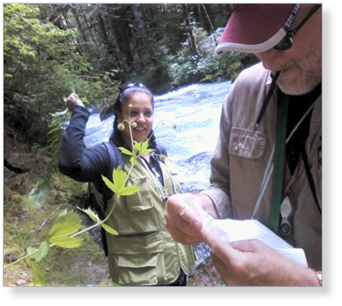
Brian’s connection to students and our place reflected in his teaching philosophy
As a final reflection, my thoughts turn to the waters of this place; waters that may be calm or turbulent, fresh or salty, hidden away and under the surface of the earth, or present in all-encompassing torrential downpours. In all its different manifestations water remains sacred, restorative and necessary, attributes I regard as inherent to teaching and learning at Northwest Indian College.
Notes:
Brian is an important leader in the development of NWIC’s Teaching and Learning Initiative. Most significantly, he has found his own experiences with the Initiative to have strengthened his teaching practice and improved his already close working relationships with his students and colleagues, resulting in greater student engagement.

Slide 36
Faculty Development Resources
Faculty web resources http://blogs.nwic.edu/faculty
Access to print and media resources
Teaching Toolkit - methodologies - readings - learning commons resources - blogs
Action Research Reports
Shared readings:
- Culture and Tradition in the Millennium
- The Hank Adams Reader
- Numerous articles posted on the Teaching and Learning Initiative web site
Notes:
The web resources consist of three web sites: the Faculty Home Page, the Teaching and Learning Initiative, and the Learning Commons. The faculty home page is the starting point for the web resources with links to the Teaching and Learning Initiative and the Learning Commons. The Teaching and Learning Initiative web site has numerous resources, including the toolkits, action research reports, articles and readings, in-service documents and presentations, and proceedings of the Teaching and Learning Institute. Faculty are currently reading and discussing the Hank Adams Reader as part of the faculty in-service activities.

Slide 37
Action Research Project Rethinking Precollege Math: Measuring Student Attributes
Faculty: Matteo Tamburini, Cassandra Cook, John Frey,
Jessica Urbanec (the Math FIG)
Project intervention: restructure class time, introduce “number talks,” restructure grading scheme, refocus course topics
Assessment: - course assessments - survey and periodic interviews
Notes:
* Instructional intervention: (1) Institute a policy whereby the instructor asks a question related to the homework to the class, collects the answers, and conducts an on-the-spot formative assessment activity; (2) introduce number talks with the goals of improving student critical thinking and their performance on factoring/ multiplication of polynomials, as well as to change student perceptions of mathematics; (3) revamped the grading scheme from a points-based system to a more course-outcome-completion oriented one; (4) judiciously removed certain parts of the curriculum with the goal of helping students master the remaining concepts more deeply.
Assessment: A combination of direct measures of student achievement of course outcomes plus surveys and interviews of students throughout the course.
*This project emerged from the work plan of the Math Faculty Inquiry Group (FIG).

Slide 38
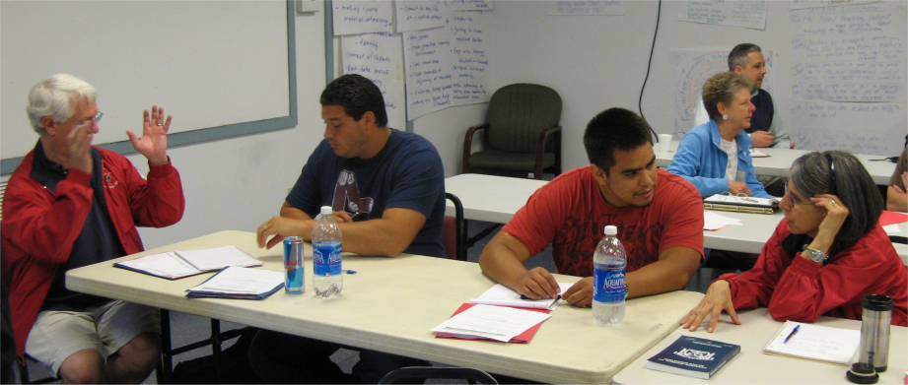
Teaching and Learning Institute Three day faculty institute - summers of 2010 and 2011
Annual event that brings together full-time and part-time faculty, from all NWIC sites
Focus on specific teaching and learning topics, including college readiness, cultural integration, action research, and Native leadership.
Facilitates interaction between full- and part-time faculty and between faculty from different educational sites
Allows for deeper discussion of teaching and learning and cultural integration
Notes:
The proceedings of the 2011 Teaching and Learning Institute , including videos, PowerPoint presentations and faculty group notes are available on the Teaching and Learning Initiative web site.

Slide 39
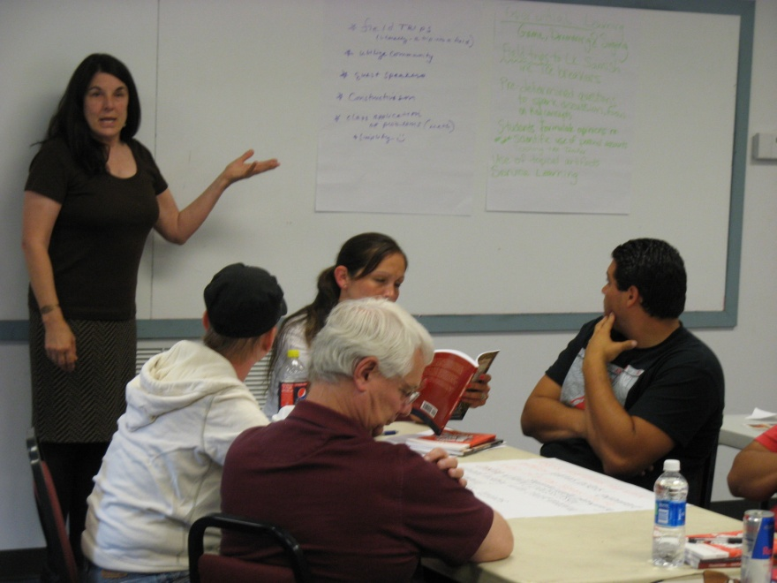
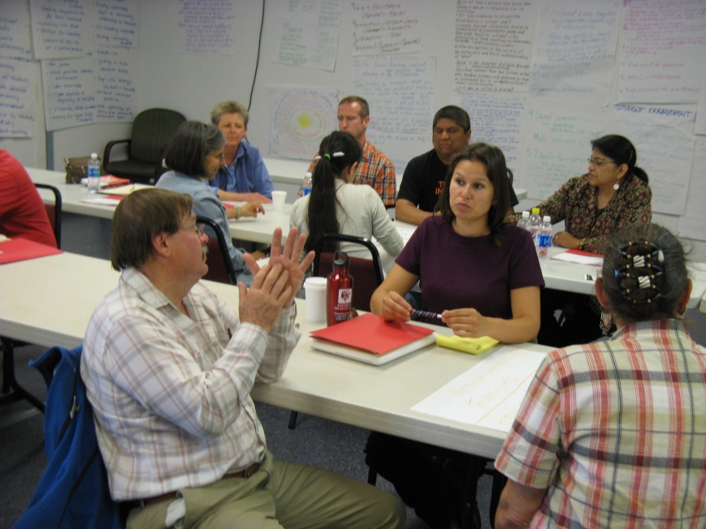
Teaching and Learning Institute
Over 30 faculty plus academic administrators attended in 2010 and 2011
Participants’ evaluations overwhelmingly indicate that the Institute met or exceeded hoped for outcomes
Institutionalized as an annual event
Notes:
Photos: Faculty group presentation and discussions at the 2011 Teaching and Learning Institute.

Slide 40
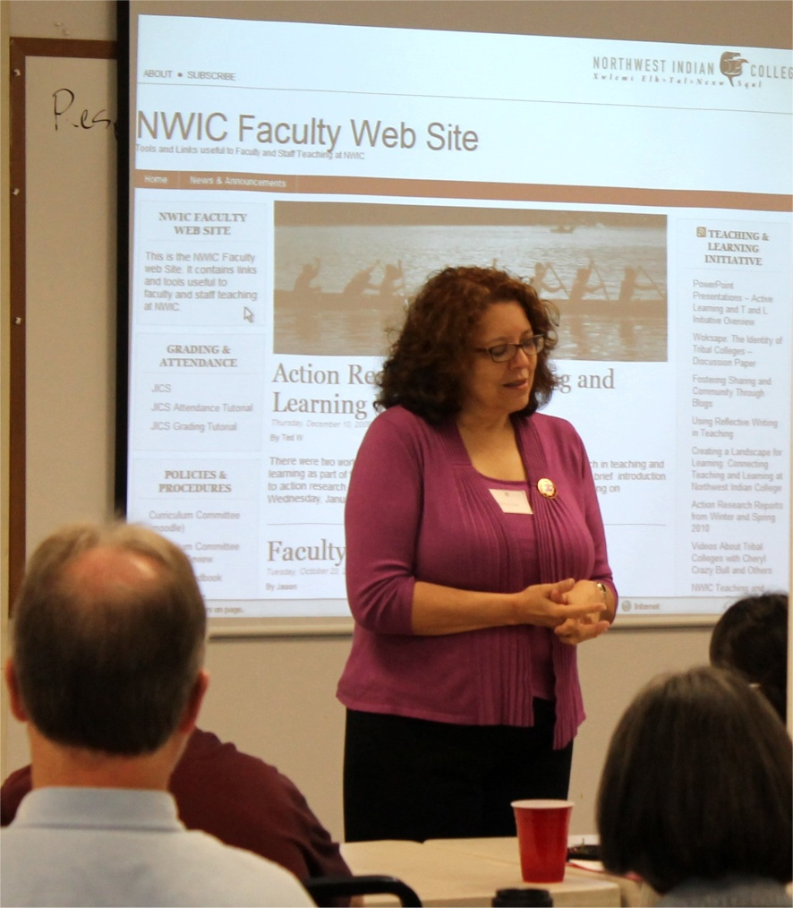
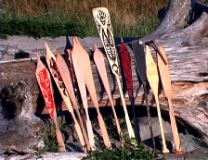
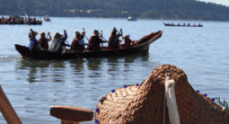
Institutional Impact
Notes:
Left photo: NWIC President Cheryl Crazy Bull presenting at the 2011 Teaching and Learning Institute. Bottom photo: NWIC’s new Center for Student Success building. Top and right photos: traditional Coast Salish paddles, cedar hat and canoe.

Slide 41
Institutional Impact Academic Excellence
Evaluations demonstrate incorporate of new methodologies
Faculty have incorporated learning from action research projects into courses
Program and course outcomes and strategies demonstrate more place-based, culturally relevant and current curricula
Increased and higher expectations for student performance
Increased focus on student completion
Increased participation in teaching and learning activities with a research, best practice focus
Notes:
In summary, we have improved our faculty and student evaluation processes, 14 action research projects were completed or are underway, course and programs outcomes substantially reflect place-based learning and the College has an institutionalized focus on continuous improvement.

Slide 42
Institutional Impact Challenging Learning Environment
Faculty focus on - enhanced curricula - instructional approaches - new outcomes and assessment strategies
Use of informal, just-in-time assessment
Rethinking Math project
Increased faculty understanding of tribal education
Deeper discussions
Increased collaboration
Notes:
Increased faculty focus and discussion on enhanced curricula, instructional approaches and development of new outcomes and assessment strategies, increased use of informal, just-in-time assessment of student learning. The Rethinking Math project opened door to “added value” course syllabi.
Faculty are more grounded in their understanding of tribal education. Presentations and discussions with Native scholars, such as Gregory Cajete, David Wilkins, and Dan Wildcat, facilitated deeper discussion of the relationships between teaching, relevancy and assessment of learning. There was increased collaboration among colleagues and most importantly, between faculty and students.

Slide 43
Institutional Impact Strategic Approach
NWIC core themes and Strategic Plan emphasize student success and indigenous knowledge
NWIC Board of Trustees adopted Student Success goals
Continuous improvement model supported by data-informed decision making
Additional institutional resources attracted in support of Student Success Agenda and promotion of tribal mission
Notes:
The Woksape Oyate project as part of our institution-wide initiatives informed our evolution as a tribal college. We are becoming increasingly able to describe and implement strategies that translate traditional understanding into a contemporary educational setting. As an educational institution, we are compelled to create frameworks such as a strategic plan and to respond to accreditation and public accountability. Woksape Oyate has contributed to the focus on student success and faculty capability in those processes. Additional resources such as the Wal-Mart Initiative, College Spark First Year Experience study and Achieving the Dream were attracted, in part, because we were engaged in this Woksape Oyate project.

Slide 44
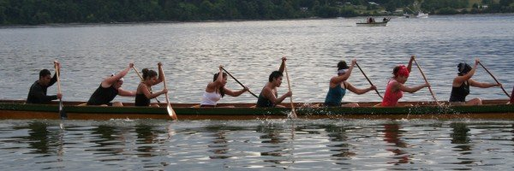
The NWIC Model Ingredients for Success
Commitment of Leadership
Development of Shared Governance
Multiple approaches to faculty development
Incentives for participation
Integrated approach
Notes:
Multiple approaches to faculty development include: teaching toolkit, web and print resource materials, action research projects and reports, training including internal and external presenters, faculty discussions, and conferences. Incentives for participation include: awards, opportunities to publish and present, support for data collection and analysis. Integrated approach uses all resources to focus on student access, learning, and completion.

Slide 45
The NWIC Model Summary of Our Success – A Tribal College Pedagogy of Teaching and Learning
Student success and academic excellence
promotes student self-identity, and
strives for indigenous knowledge as the foundation of all programs of study
Faculty enhance the teaching and learning experience
through curriculum design that is relevant and current
action research projects
toolkit contributions on teaching methodologies and practices
making changes in curriculum and instruction, particularly influencing classroom practices and academic content
Native faculty and leadership lead the process of
curricular change and development,
improvement and promotion of high expectations
research, and intellectual capacity building
Notes:
Building intellectual capacity at NWIC through the support of Woksape Oyate and other initiatives focused on the cultural competencies and content-area knowledge of faculty along with improving the pedagogy of teaching and learning from a tribal perspective. As we continue our evaluation of the project, we focus on three areas of impact – faculty, students and the institution.

Slide 46
NWIC Academic Model: Promote a Holistic and Integrated Teaching and Learning Environment
Achieving the Dream
First Year Experience
Teaching and Learning Initiative
Student
Success Agenda
College Mission
Identity
Sense of Place
Self-Determination
Sovereignty
First Generation Students
Indigenous Service Learning
Assessment
of
Student
Learning
Academic
Leadership
Faculty Inquiry Groups (FIGs)
Research and
Faculty
Development
Student Services Support of Academics
Notes:
This diagram represents the image of all of the sacred knowledge that comes from the Creator entering into our teaching and learning practices which supports our Student Success!

