Slide 1
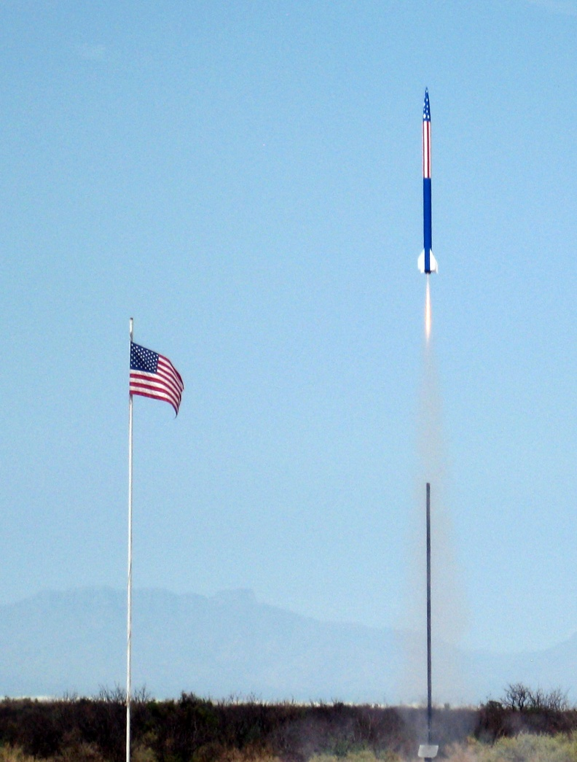
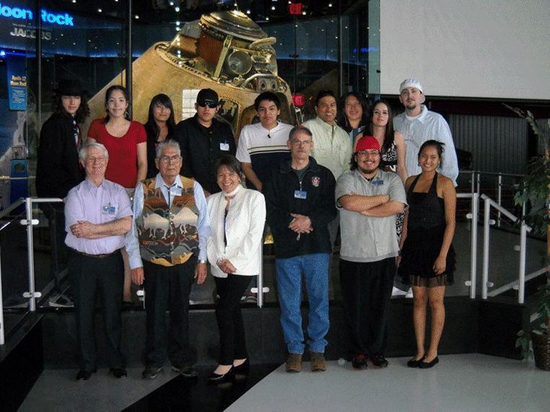
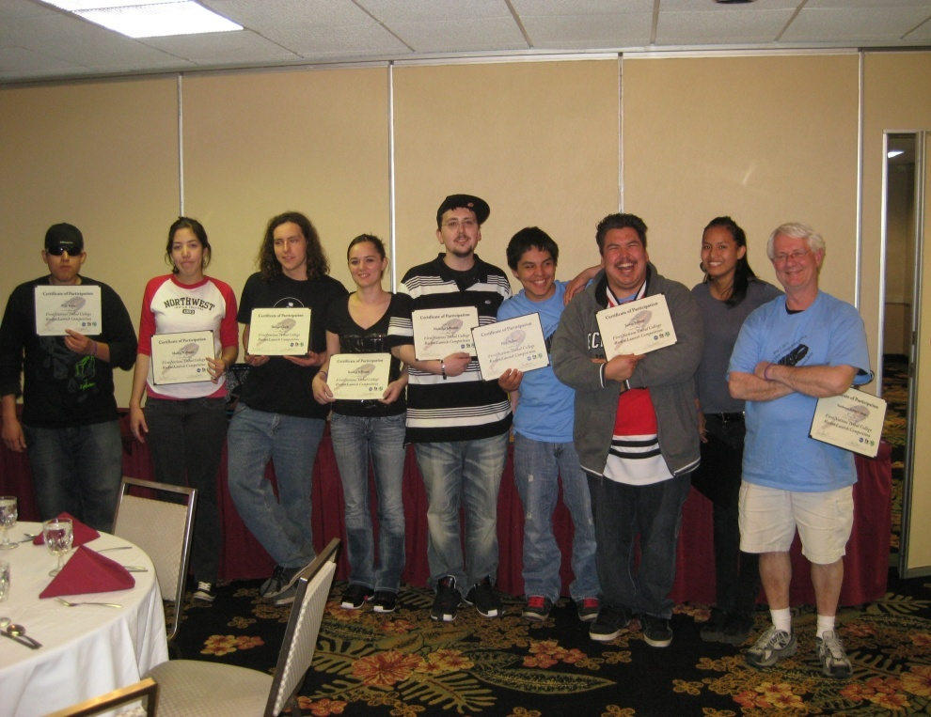
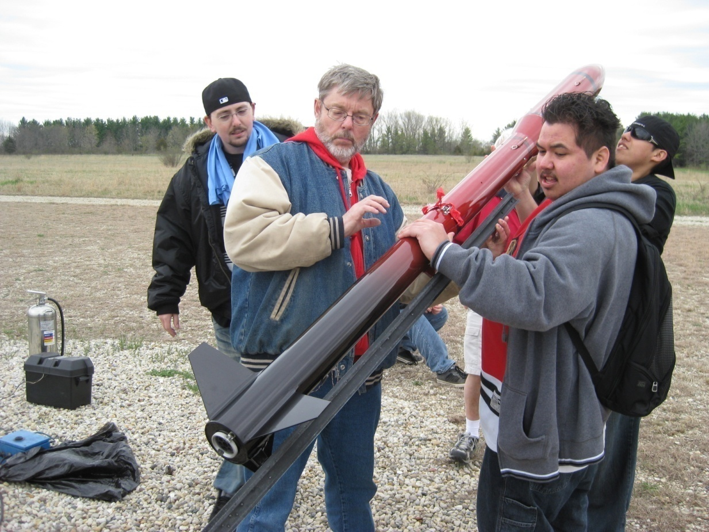
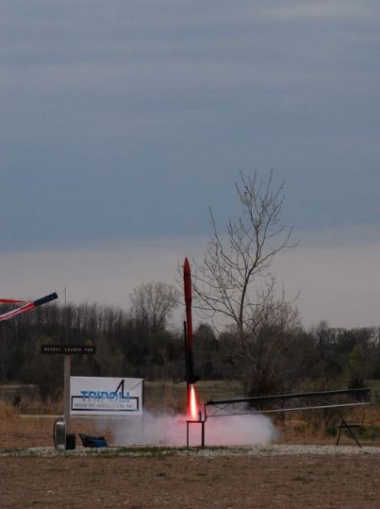
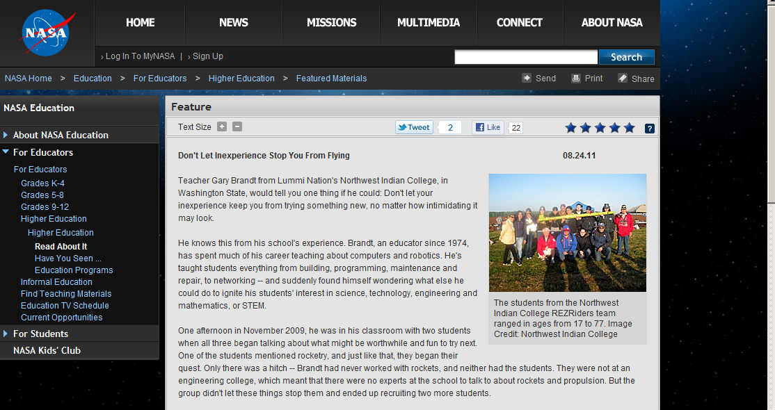
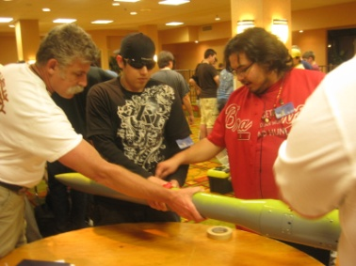
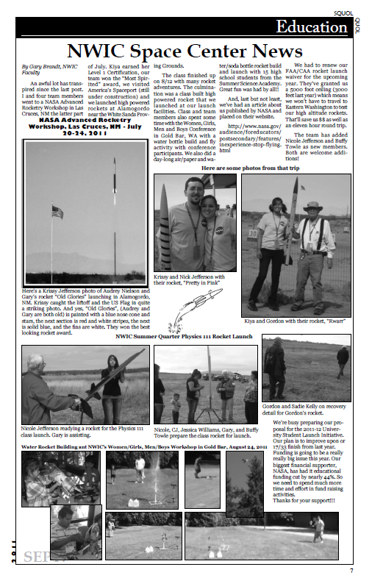
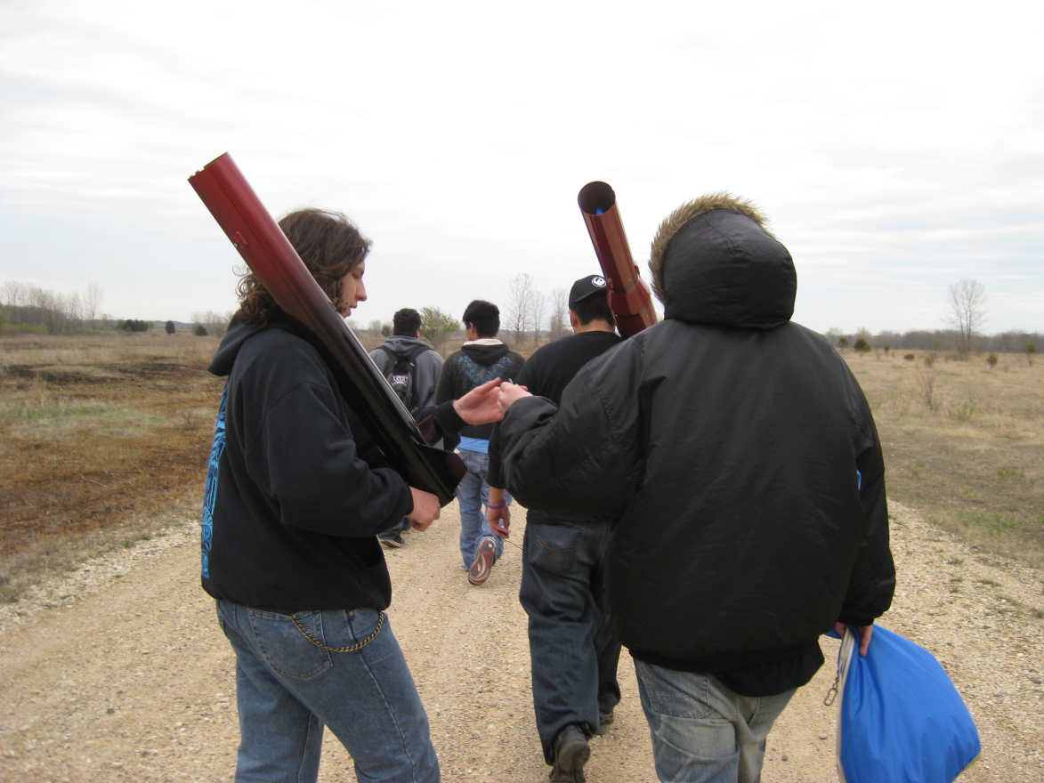
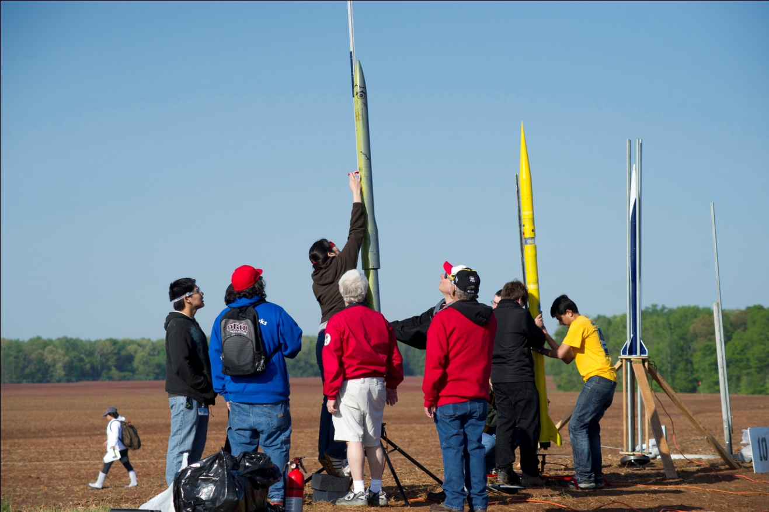
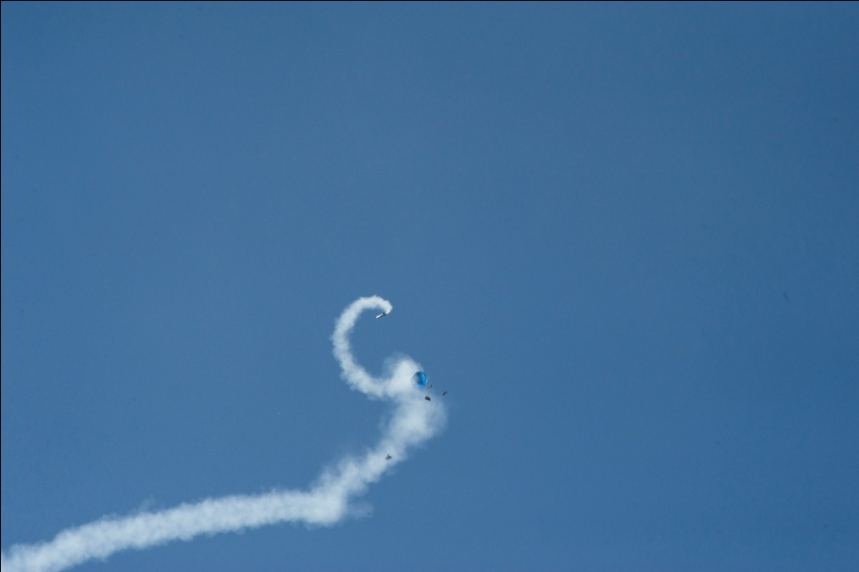
USLI Team
Mariya Williams-Team leader
Kiya Gorman
Kiyen Gorman
Justin Johnny
Nick Jefferson
Kristina Jefferson
Kyle Koos
Paul Ballew
Gordon Kelly
Patrisha Lane
Cathy Ballew
Thomas Doyle
Gary Brandt-Advisor
Dave Oreiro-Advisor
Bill Munds-NAR Mentor
First Nations Team
Justin Johnny-Team leader
Kiya Gorman
Mariya Williams
Nick Jefferson
Kristina Jefferson
Kyle Koos
Paul Ballew
Thomas Doyle
Gary Brandt-Advisor
2010-2011 REZRiders
University Student Launch Initiative
Huntsville, Al – 17th Place
First Nations Launch
Milwaukee, WI - 1st Place Tribal Competition
NASA Advance Rocketry Workshop
Las Cruces, NM – 1st Place, Design, 1st Place Team Spirit

